Slide 1

3.<number>
Chapter 3
Data and Signals
Copyright © The McGraw-Hill Companies, Inc. Permission required for reproduction or display.

Slide 2
3-1 ANALOG AND DIGITAL
3.<number>
Topics discussed in this section:
Analog and Digital Data
Analog and Digital Signals
Periodic and Nonperiodic Signals

Slide 3
3.<number>
Analog vs. Digital Data
Analog data
  _{Data take on continuous values}
  E.g., human voice, your weights, temperature reading
  Numerical representation: real numbers
Digital data
  _{Data take on discrete values}
  E.g., number of students in class, text data
  Numerical representation: integers

Slide 4
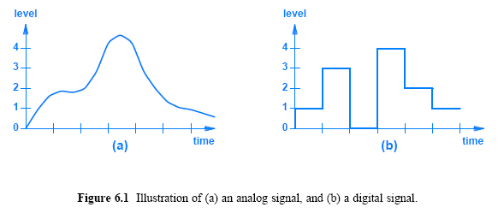
Analog vs. Digital Signals
To be transmitted, data must be
transformed to electromagnetic signals
Analog signals
  have an infinite number of
  values in a range
Digital signals
  Have a limited number of
  values

Slide 5
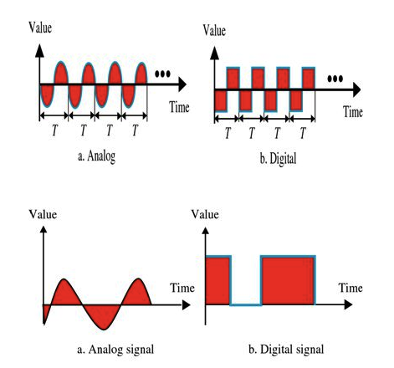
Periodic and Non Periodic Signals
3.<number>
In data communications, we commonly use
  Periodic analog signals
  Non periodic digital signals.

Slide 6
3-2 PERIODIC ANALOG SIGNALS
3.<number>
Topics discussed in this section:
Sine Wave
Wavelength
Time and Frequency Domain
Composite Signals
Bandwidth

Slide 7

Sine Wave
3.<number>
Periodic analog signals can be classified as simple or composite. A simple periodic analog signal, a sine wave, cannot be decomposed into simpler signals. A composite
periodic analog signal is composed of multiple sine waves.
Figure 3.2 A sine wave

Slide 8
Sine Signal Characteristics
Frequency ( f ):
  the number of oscillations per unit time (usually seconds)
Amplitude ( A ):
  the difference between the maximum and minimum signal heights
Phase ( φ ):
  how far the start of the sine wave is shifted from a reference time

Slide 9
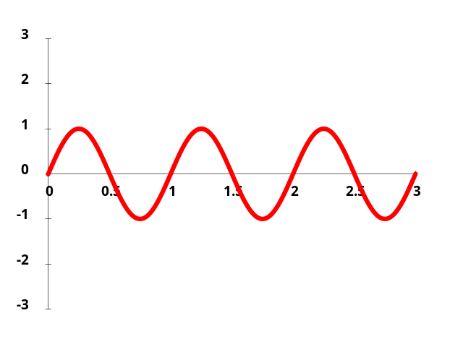
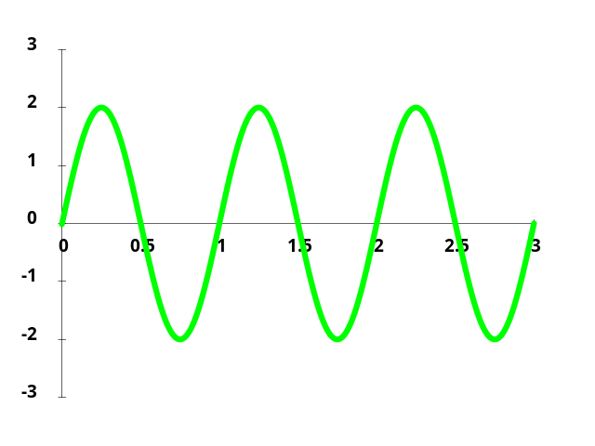
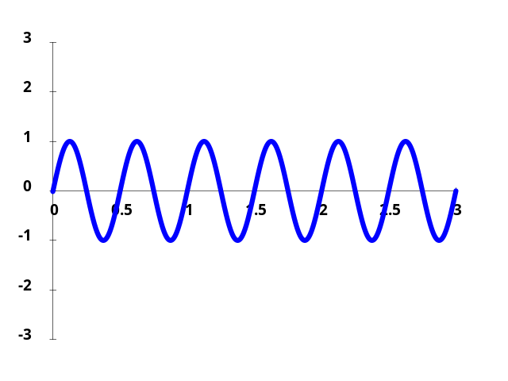
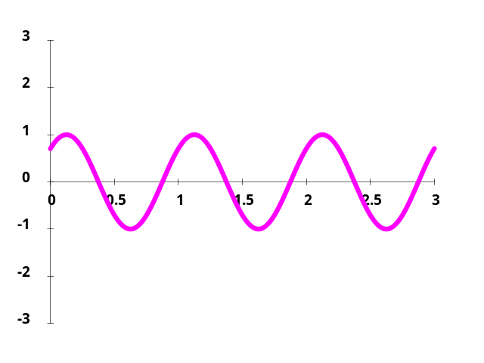
Varying Sine Waves
A = 1, f = 1, φ = 0
A = 2, f = 1, φ = 0
A = 1, f = 2, φ = 0
A = 1, f = 1, φ = π/4

Slide 10

Figure 3.3 Two signals with the same phase and frequency,
but different amplitudes
3.<number>

Slide 11


3.<number>
Note
Frequency and period are the inverse of each other.

Slide 12

Figure 3.4 Two signals with the same amplitude and phase,
but different frequencies
3.<number>

Slide 13

Example 3.3
3.<number>
The power we use at home has a frequency of 60 Hz. The period of this sine wave can be determined as follows:

Slide 14

Example 3.5
3.<number>
The period of a signal is 100 ms. What is its frequency in kilohertz?
Solution
First we change 100 ms to seconds, and then we calculate the frequency from the period (1 Hz = 10⁻³ kHz).

Slide 15
3.<number>
Note
Frequency is the rate of change with respect to time.
Change in a short span of time
means high frequency.
Change over a long span of
time means low frequency.

Slide 16
3.<number>
Note
If a signal does not change at all, its frequency is zero.
If a signal changes instantaneously, its frequency is infinite.

Slide 17

Figure 3.5 Three sine waves with the same amplitude and frequency,
but different phases
3.<number>
Phase describes the position of the waveform relative to time 0.

Slide 18


3.<number>
Figure 3.6 Wavelength and period
Wavelength binds the period or the frequency of a simple sine wave to the propagation speed of the medium
Wavelength can be calculated if one is given the propagation speed (the speed of light) and the period of the signal.

Slide 19

3.<number>
Figure 3.7 The time-domain and frequency-domain plots of a sine wave

Slide 20
3.<number>
Note
A single-frequency sine wave is not useful in data communications;
we need to send a composite signal, a signal made of many simple sine waves.

Slide 21

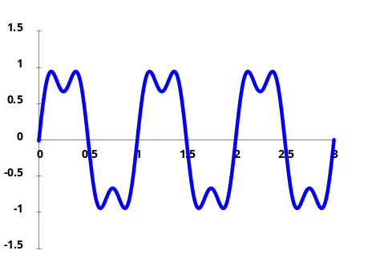
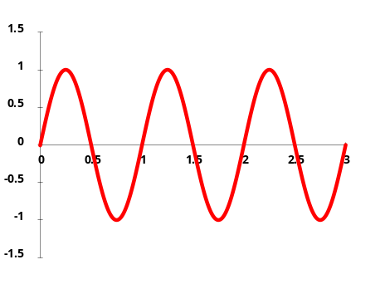
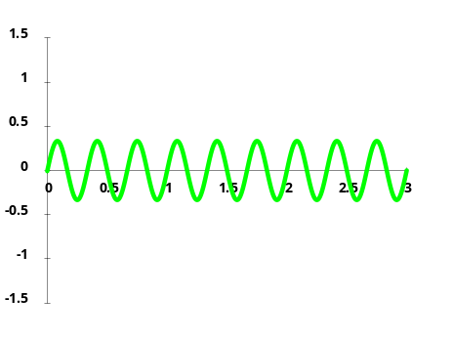
Composite Signals
A mathematician named Fourier
discovered that
  It is possible to decompose a composite signal into series of sine functions
    Each with different frequency, amplitude, and phase
Joseph Fourier
(1768-1830)
=
+

Slide 22

3.<number>
Figure 3.9 A composite periodic signal

Slide 23

3.<number>
Figure 3.8 The time domain and frequency domain of three sine waves

Slide 24
Bandwidth
3.<number>
The range of frequencies contained in a composite signal is its bandwidth.
The bandwidth of a composite signal is the difference between the highest and the lowest frequencies contained in that signal.
Bandwitdh = fh - fl

Slide 25

Figure 3.12 The bandwidth of periodic and nonperiodic composite signals
3.<number>

Slide 26

Example 3.10
3.<number>
If a periodic signal is decomposed into five sine waves with frequencies of 100, 300, 500, 700, and 900 Hz, what is its bandwidth? Draw the spectrum, assuming all components have a maximum amplitude of 10 V.
Solution
Let f_{h} be the highest frequency, f_{l} the lowest frequency, and B the bandwidth. Then
The spectrum has only five spikes, at 100, 300, 500, 700, and 900 Hz (see Figure 3.13).

Slide 27

3.<number>
Figure 3.13 The bandwidth for Example 3.10

Slide 28
3-3 DIGITAL SIGNALS
3.<number>
In addition to being represented by an analog signal, information can also be represented by a digital signal. For example, a 1 can be encoded as a positive voltage and a 0 as zero voltage. A digital signal can have more than two levels. In this case, we can send more than 1 bit for each level.
Topics discussed in this section:
Bit Rate
Digital Signal as a Composite Analog Signal

Slide 29

Figure 3.16 Two digital signals: one with two signal levels and the other
with four signal levels
3.<number>

Slide 30
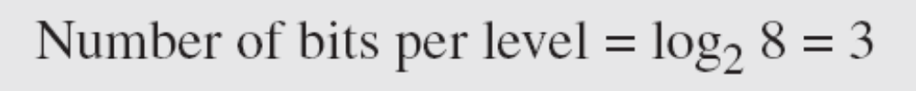
3.<number>
In general, if a signal has L levels, each level needs
Number of bits per level= log2 L bits.
Example 3.16
A digital signal has eight levels. How many bits are needed per level? We calculate the number of bits from the formula
Each signal level is represented by 3 bits.

Slide 31
Example 3.17
3.<number>
A digital signal has nine levels. How many bits are needed per level? We calculate the number of bits by using the formula.
Each signal level is represented by 3.17 bits.
However, this answer is not realistic.
The number of bits sent per level needs to be an integer as well as a power of 2. For this example, 4 bits can represent one level.

Slide 32
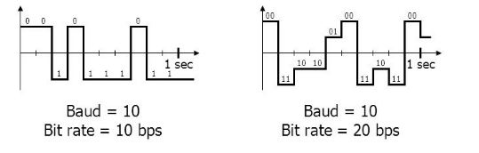
Bit Rate
3.<number>
Most digital signals are non periodic, and thus period and frequency are not appropriate characteristics.
So bit rate (instead of frequency)—is used to describe
digital signals.
The bit rate is the number of bits sent in 1s, expressed in bits per second (bps).

Slide 33
Example 3.18
3.<number>
Assume we need to download text documents at the rate of 100 pages per minute. What is the required bit rate of the channel?
Solution
A page is an average of 24 lines with 80 characters in each line. If we assume that one character requires 8 bits, the bit rate is

Slide 34
Example 3.19
3.<number>
A digitized voice channel, as we will see in Chapter 4, is made by digitizing a 4-kHz bandwidth analog voice signal. We need to sample the signal at twice the highest frequency (two samples per hertz). We assume that each sample requires 8 bits. What is the required bit rate?
Solution
The bit rate can be calculated as

Slide 35
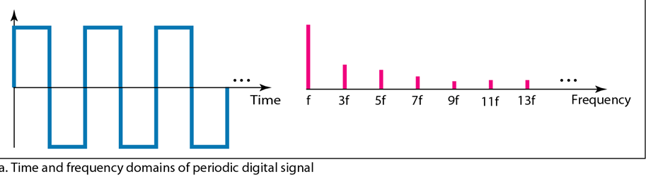
Digital Signal as a Composite Analog Signal
3.<number>
Fourier analysis can be used to decompose a digital signal.
If the digital signal is periodic, which is rare in data communications, the decomposed signal has a frequency domain representation with an infinite bandwidth and discrete frequencies.
Figure 3.17 The time and frequency domains of periodic digital signals

Slide 36
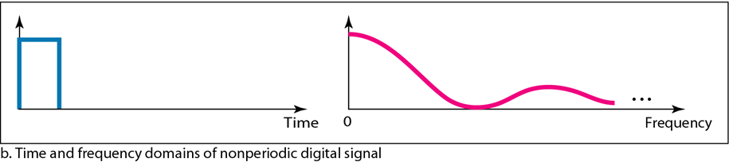
Digital Signal as a Composite Analog Signal
3.<number>
If the digital signal is non periodic, the decomposed signal still has an infinite bandwidth, but the frequencies are continuous.
Figure 3.17 The time and frequency domains of periodic and nonperiodic
digital signals

Slide 37
3-4 TRANSMISSION IMPAIRMENT
3.<number>
Signals travel through transmission media, which are not perfect. The imperfection causes signal impairment. This means that the signal at the beginning of the medium is not the same as the signal at the end of the medium. What is sent is not what is received. Three causes of impairment are attenuation, distortion, and noise.
Topics discussed in this section:
Attenuation
Distortion
Noise

Slide 38

3.<number>
Figure 3.25 Causes of impairment

Slide 39

3.<number>
Figure 3.26 Attenuation

Slide 40

Decibel
3.<number>
To show that a signal has lost or gained strength, engineers use the unit of the decibel.
The decibel (dB) measures the relative strengths of two signals or one signal at two different points.
Note that the decibel is negative if a signal is attenuated and positive if a signal is amplified.
Variables P1 and P2 are the powers of a signal at points 1 and 2, respectively.

Slide 41

Example 3.26
3.<number>
Suppose a signal travels through a transmission medium and its power is reduced to one-half. This means that P2 is (1/2)P1. In this case, the attenuation (loss of power) can be calculated as
A loss of 3 dB (–3 dB) is equivalent to losing one-half the power.

Slide 42


Example 3.27
3.<number>
A signal travels through an amplifier, and its power is increased 10 times. This means that P₂ = 10P₁ . In this case, the amplification (gain of power) can be calculated as

Slide 43

Example 3.28
3.<number>
One reason that engineers use the decibel to measure the changes in the strength of a signal is that decibel numbers can be added (or subtracted) when we are measuring several points (cascading) instead of just two. In Figure 3.27 a signal travels from point 1 to point 4. In this case, the decibel value can be calculated as

Slide 44

3.<number>
Figure 3.27 Decibels for Example 3.28

Slide 45

3.<number>
Figure 3.28 Distortion

Slide 46

3.<number>
Figure 3.29 Noise

Slide 47


Signal to Noise Ratio
3.<number>
SNR is actually the ratio of what is wanted (signal) to what is not wanted (noise).
A high SNR means the signal is less corrupted by noise; a low SNR means the signal is more corrupted by noise.
Because SNR is the ratio of two powers, it is often described in decibel units, SNRdB, defined as

Slide 48

3.<number>
Figure 3.30 Two cases of SNR: a high SNR and a low SNR

Slide 49

Example 3.31
3.<number>
The power of a signal is 10 mW and the power of the noise is 1 μW; what are the values of SNR and SNR_{dB} ?
Solution
The values of SNR and SNRdB can be calculated as follows:

Slide 50

Example 3.32
3.<number>
The values of SNR and SNRdB for a noiseless channel are
We can never achieve this ratio in real life; it is an ideal.

Slide 51
3-5 DATA RATE LIMITS
3.<number>
A very important consideration in data communications is how fast we can send data, in bits per second, over a channel. Data rate depends on three factors:
1. The bandwidth available
2. The level of the signals we use
3. The quality of the channel (the level of noise)
Topics discussed in this section:
Noiseless Channel: Nyquist Bit Rate
Noisy Channel: Shannon Capacity
Using Both Limits

Slide 52
3.<number>
Note
Increasing the levels of a signal may reduce the reliability of the system.
Noiseless Channel: Nyquist Bit Rate
Defines theoretical maximum bit rate for Noiseless Channel:
Bit Rate=2 X Bandwidth X log₂L

Slide 53
Example 3.34
3.<number>
Consider a noiseless channel with a bandwidth of 3000 Hz transmitting a signal with two signal levels. The maximum bit rate can be calculated as
Example 3.35
Consider the same noiseless channel transmitting a signal with four signal levels (for each level, we send 2 bits). The maximum bit rate can be calculated as

Slide 54

Example 3.36
3.<number>
We need to send 265 kbps over a noiseless channel with a bandwidth of 20 kHz. How many signal levels do we need?
Solution
We can use the Nyquist formula as shown:
Since this result is not a power of 2, we need to either increase the number of levels or reduce the bit rate. If we have 128 levels, the bit rate is 280 kbps. If we have 64 levels, the bit rate is 240 kbps.

Slide 55
Noisy Channel: Shannon Capacity
Defines theoretical maximum bit rate for Noisy Channel:
Capacity=Bandwidth X log₂(1+SNR)

Slide 56
Example 3.37
3.<number>
Consider an extremely noisy channel in which the value of the signal-to-noise ratio is almost zero. In other words, the noise is so strong that the signal is faint. For this channel the capacity C is calculated as
This means that the capacity of this channel is zero regardless of the bandwidth. In other words, we cannot receive any data through this channel.

Slide 57
Example 3.38
3.<number>
We can calculate the theoretical highest bit rate of a regular telephone line. A telephone line normally has a bandwidth of 3000. The signal-to-noise ratio is usually 3162. For this channel the capacity is calculated as
This means that the highest bit rate for a telephone line is 34.860 kbps. If we want to send data faster than this, we can either increase the bandwidth of the line or improve the signal-to-noise ratio.

Slide 58
Example 3.39
3.<number>
The signal-to-noise ratio is often given in decibels. Assume that SNR_{dB} = 36 and the channel bandwidth is 2 MHz. The theoretical channel capacity can be calculated as

Slide 59


Example 3.40
3.<number>
For practical purposes, when the SNR is very high, we can assume that SNR + 1 is almost the same as SNR. In these cases, the theoretical channel capacity can be simplified to
For example, we can calculate the theoretical capacity of the previous example as

Slide 60
Example 3.41
3.<number>
We have a channel with a 1-MHz bandwidth. The SNR for this channel is 63. What are the appropriate bit rate and signal level?
Solution
First, we use the Shannon formula to find the upper limit.

Slide 61
Example 3.41 (continued)
3.<number>
The Shannon formula gives us 6 Mbps, the upper limit. For better performance we choose something lower, 4 Mbps, for example. Then we use the Nyquist formula to find the number of signal levels.

Slide 62
3.<number>
Note
The Shannon capacity gives us the upper limit; the Nyquist formula tells us how many signal levels we need.

Slide 63
3-6 PERFORMANCE
3.<number>
One important issue in networking is the performance of the network—how good is it? We discuss quality of service, an overall measurement of network performance, in greater detail in Chapter 24. In this section, we introduce terms that we need for future chapters.
Topics discussed in this section:
Bandwidth
Throughput
Latency (Delay)

Slide 64
3.<number>
Note
In networking, we use the term bandwidth in two contexts.
❏ The first, bandwidth in hertz, refers to
the range of frequencies in a
composite signal or the range of
frequencies that a channel can pass.
❏ The second, bandwidth in bits per
second, refers to the speed of bit
transmission in a channel or link.

Slide 65
Example 3.42 and 3.43
3.<number>
The bandwidth of a subscriber line is 4 kHz for voice or data. The bandwidth of this line for data transmission
can be up to 56,000 bps using a sophisticated modem to change the digital signal to analog.
If the telephone company improves the quality of the line and increases the bandwidth to 8 kHz,
we can send 112,000 bps by using the same technology as mentioned in Example 3.42.

Slide 66
Throughput
3.<number>
The throughput is a measure of how fast we can actually send data through a network.
In other words, the bandwidth is a potential measurement of a link; the throughput is an actual measurement of how fast we can send data.
  For example, we may have a link with a bandwidth of 1 Mbps, but the devices connected to the end of the link may handle only 200 kbps.
  This means that we cannot send more than 200 kbps through this link.

Slide 67

Example 3.44
3.<number>
A network with bandwidth of 10 Mbps can pass only an average of 12,000 frames per minute with each frame carrying an average of 10,000 bits. What is the throughput of this network?
Solution
We can calculate the throughput as
The throughput is almost one-fifth of the bandwidth in this case.

Slide 68
Latency or Delay
3.<number>
The latency or delay defines how long it takes for an entire message to completely arrive at the destination from the time the first bit is sent out from the source.

Slide 69
Propagation and Transmission Time
3.<number>
Propagation time measures the time required for a bit to travel from the source to the destination.
Propagation time = Distance / (Propagation Speed)
The transmission time of a message depends on the size of the message and the bandwidth of the channel.
Transmission time = (Message size) / Bandwidth

Slide 70
Example 3.46
3.<number>
What are the propagation time and the transmission time for a 2.5-kbyte message (an e-mail) if the bandwidth of the network is 1 Gbps? Assume that the distance between the sender and the receiver is 12,000 km and that light travels at 2.4 × 108 m/s.
Solution
We can calculate the propagation and transmission time as shown on the next slide:

Slide 71

Example 3.46 (continued)
3.<number>
Note that in this case, because the message is short and the bandwidth is high, the dominant factor is the propagation time, not the transmission time. The transmission time can be ignored.

Slide 72
Queuing Time
3.<number>
The third component in latency is the queuing time, the time needed for each intermediate or end device to hold the message before it can be processed.
The queuing time is not a fixed factor; it changes with the load imposed on the network.
When there is heavy traffic on the network, the queuing time increases.

